Slide 1
Principal Component Analysis of Soil CH₄ Flux in a Methane Database
Brandon Kim
High School Science/Tech Intern at JGCRI
Notes:
Image: Sequim Bay

Slide 2




Who I am
HS Intern at JGCRI
Graduated senior at Poolesville HS in the Global Ecology Program
Committed to UMD Honors College for Fall 2023

Slide 3
Atmospheric Methane

Slide 4
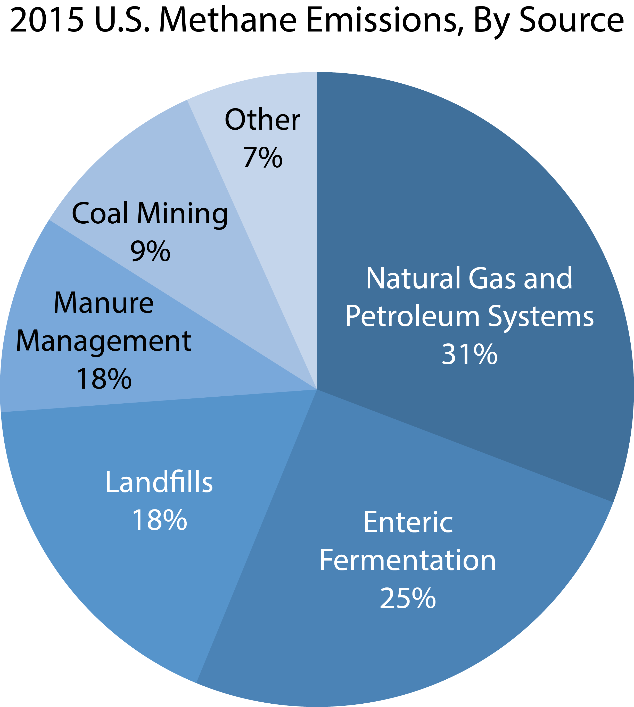
What is Methane?
Methane (CH₄) is the 2nd most abundant anthropogenic GHG
More potent at warming than CO₂
Though CH₄ has a significantly lower lifespan than CO₂
Largest anthropogenic sources come from agriculture and burning of fossil fuels
Permafrost thaw is the largest indirect source of methane
EPA estimates of U.S. methane emission sources in 2015
Image Credit: https://www.americangeosciences.org/geoscience-currents/methane-emissions-oil-and-gas-industry

Slide 5
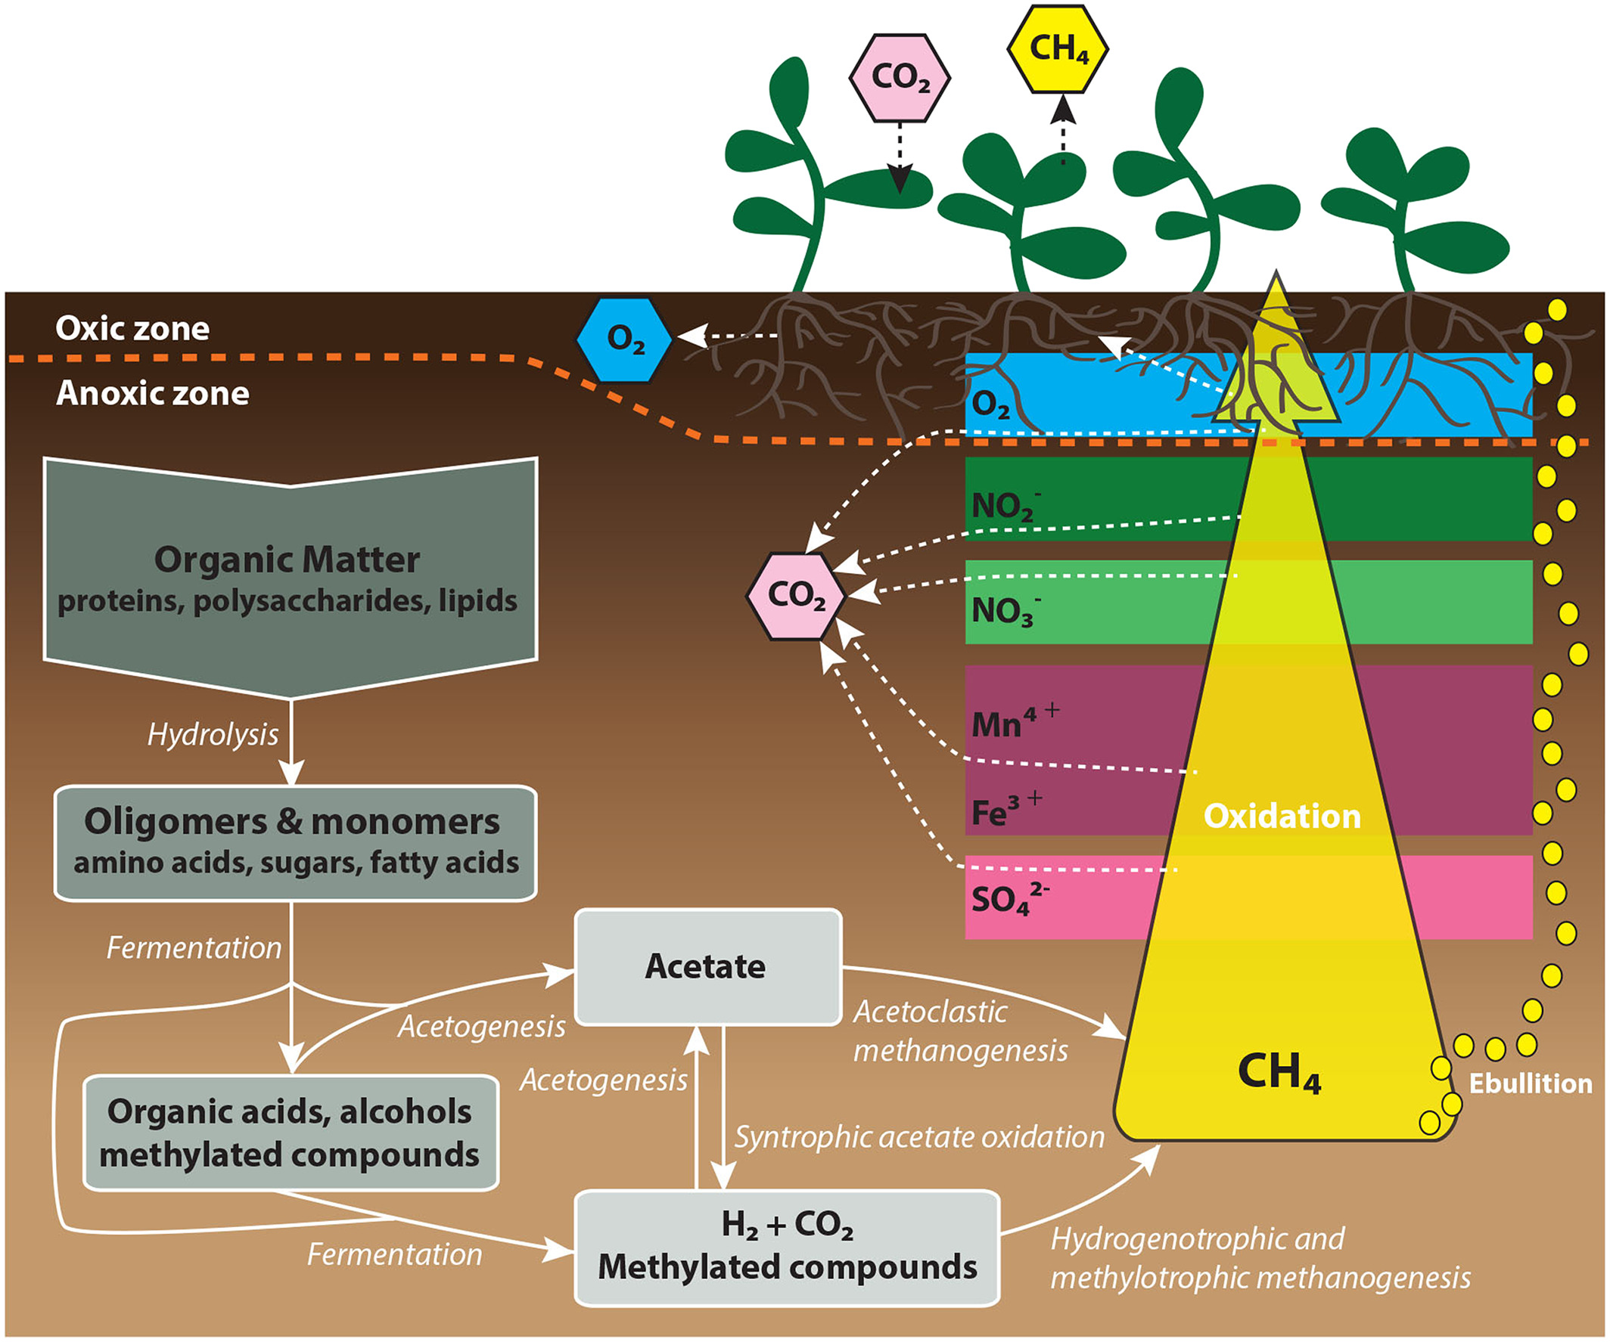
Soil Methane Flux
Caused by methanogenesis
Anaerobic respiration
Methanogens live in oxygen-free areas
Use CO₂ in the same way we use O₂
CH₄ is the product of metabolism
4H₂ + CO₂ → CH₄ + 2H₂O
Image Credit: https://agupubs.onlinelibrary.wiley.com/doi/full/10.1002/2017RG000559

Slide 6




The Threat of Climate Change on Soil CH4 Flux
Climate change increases extreme water events
Flooding
Tropical rainstorms
Increased flooding/waterlogging -> increased methanogenic activity
Creates anoxic environments suitable for methanogenesis
Global Warming
Increased storm frequency
CH₄
Typical in wetland environments
Soil flooding

Slide 7
Our Research Focus

Slide 8
Research Question
Concerned by growth of climate change on soil-to-atmosphere GHG fluxes, we wanted to know…
What ecological patterns exist in the level and duration of soil moisture, as well as other factors, for soil CH₄ flux?
We created a comprehensive database of papers that measured soil CH₄ flux with a subsequent analysis of auxiliary variables to assess the causes of CH₄ flux

Slide 9
The Methane Database

Slide 10
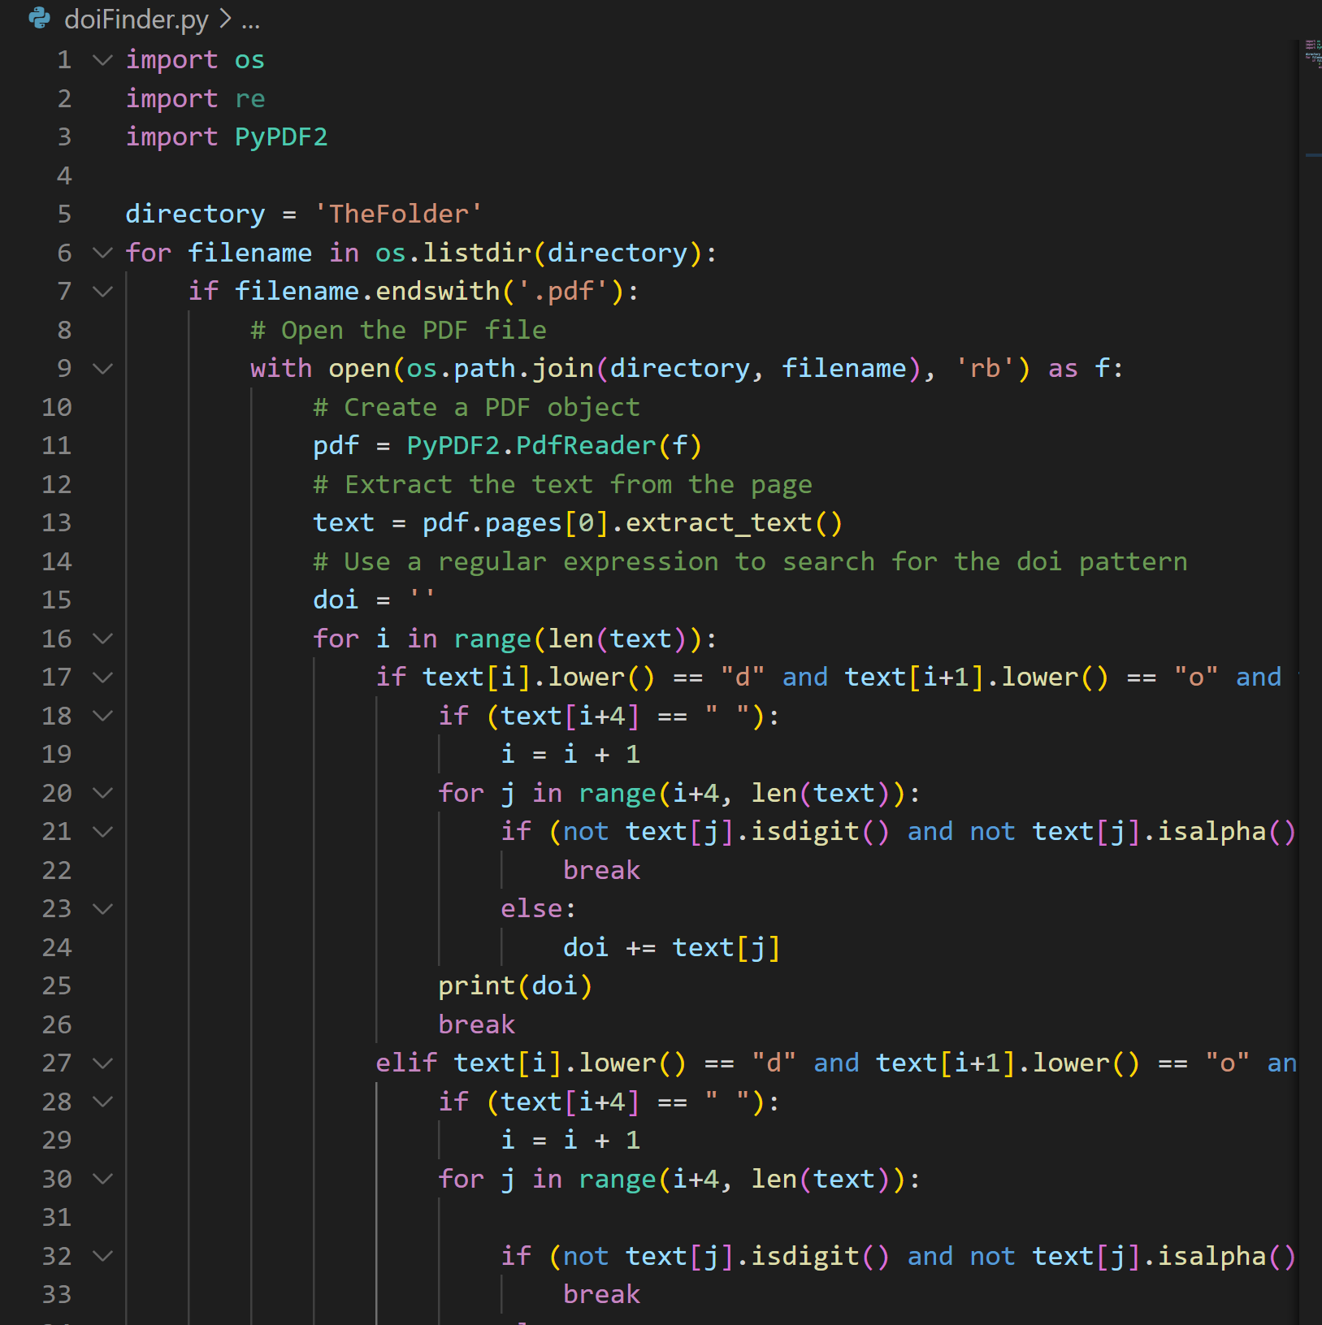
How the Methane Database was Formed
Collected 70+ research studies that contained soil methane fluxes
Used scripts to accelerate metadata ingestion
Amended columns to focus on soil moisture and CH₄ flux
Water-filled Pore Space (WFPS)
Volumetric Water Content (VWC)
CH₄ flux
Python script to identify Digital Object Identifier (DOI) and iterate through all papers

Slide 11
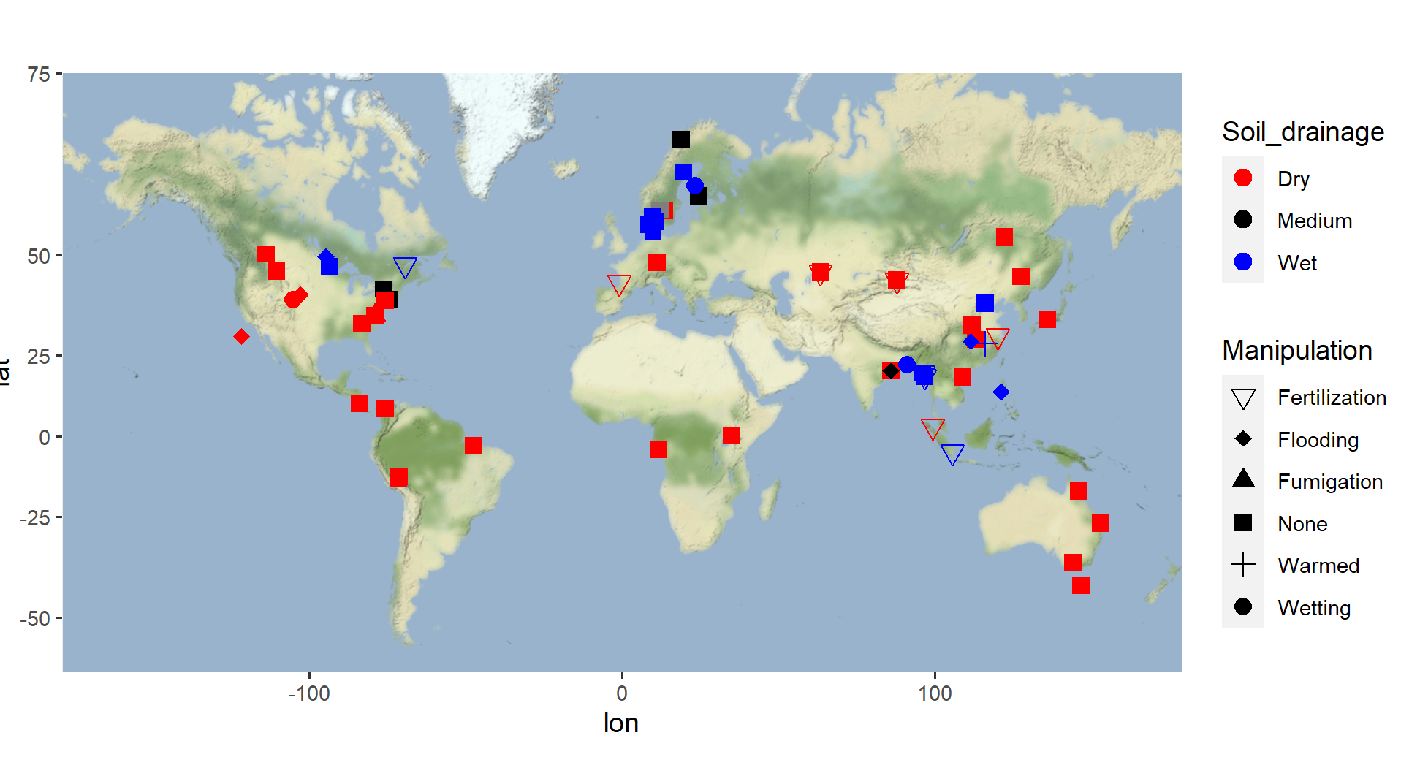
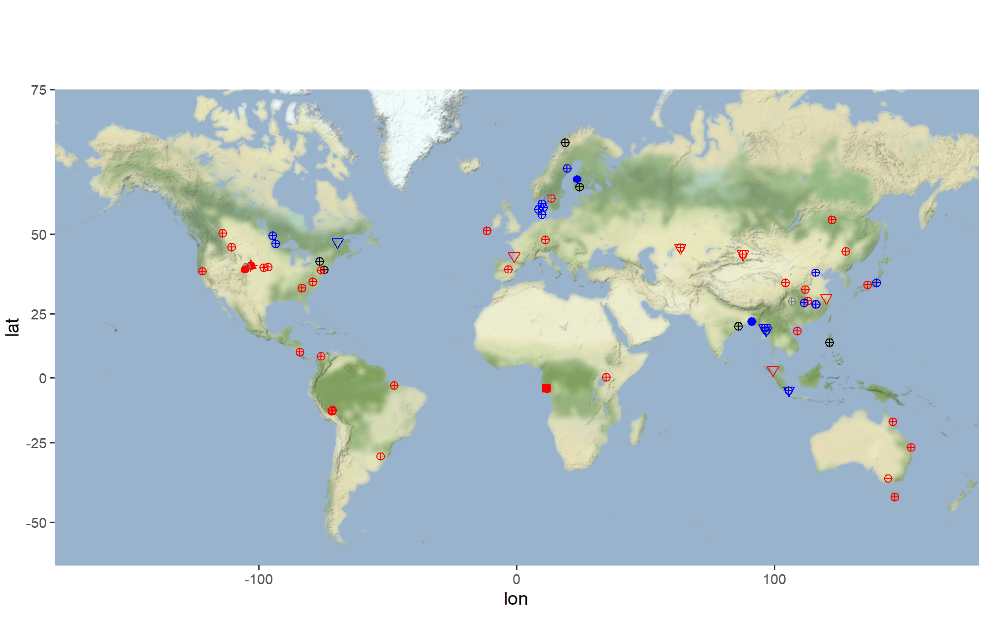
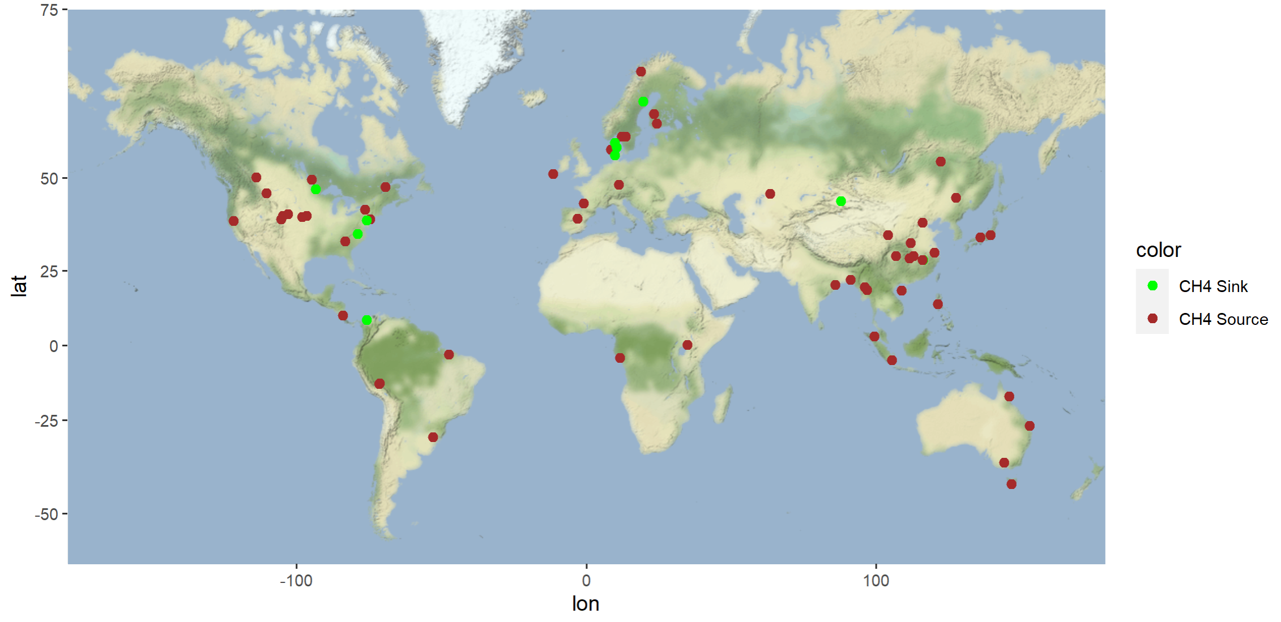
Summary
6 continents of data
32 unique treatments
Fertilization most common
Concentration in
North America
East/Southeast Asia
Northern Europe
Australia
(Top) Map of studies with their respective soil drainage and manipulation
(Bottom) Map of studies and their respective CH₄ flux direction

Slide 12
Principal Component Analysis (PCA)

Slide 13
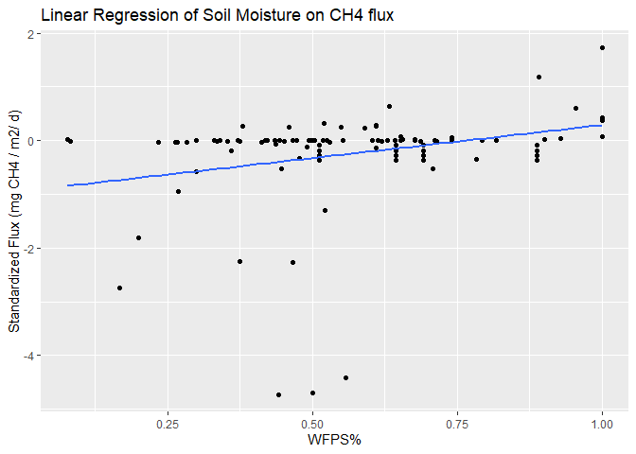
Linear Regression
Doesn’t show other variables
Limited explanation of flux variance
Questions about outliers
Linear Regression of Water Filled Pore Space (WFPS%) on the x-axis CH₄ flux (mg CH₄ / m² / day) on the y-axis

Slide 14
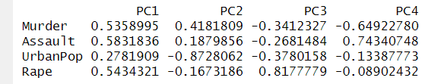
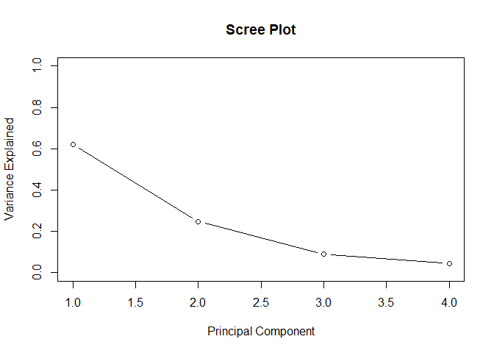
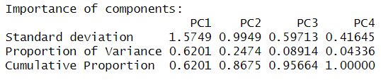
Principal Component Analysis
What is PCA?
A method to simplify multivariate data
Reduces number of factors
Uses R programming language
Why Use PCA?
Handle lots of information easily
Find patterns in data
Scree plot and PCA summary of US Arrests dataset

Slide 15
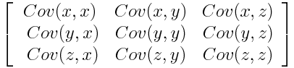
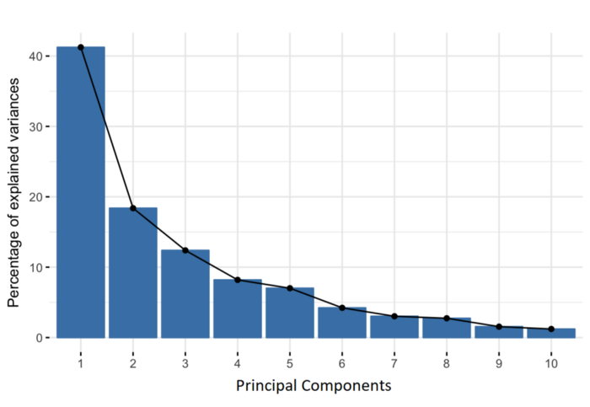
How Does it Work?
Standardize
Means set to 0 and units are scaled
Create covariance matrix
Shows direction of correlation between all variables
Example on right has 3 dimensions
Calculate eigenvectors/eigenvalues
Eigenvectors define high-variance axes (Principal Components)
Eigenvalues quantify variance carried by each Principal Component
There is one eigen-”pair” for each dimension

Slide 16

Summary of PCA
PCA squeezes as much variance into first few principal components
Calculated by the strength of covariance between each dimension
Each descending PCA will explain less of the variance in a dataset

Slide 17
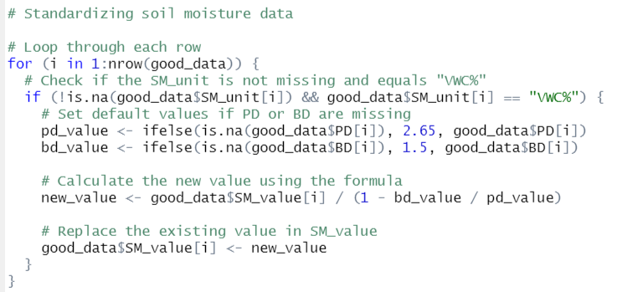
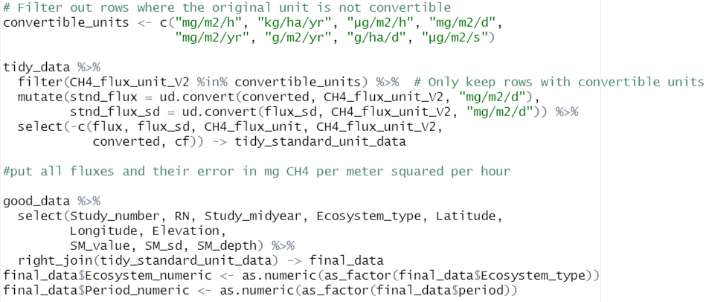
Preparing the Data
Data transformation
Soil moisture units (WFPS and VWC)
Standardization of CH₄ flux into one unit (mg CH₄ / m² / day)
Filtering data
Manipulated plots (e.g. fumigation)
Null values
“Quantifying” categorical data
Ecosystem numeric
Filling in gaps
Assumptions made for bulk/particle density

Slide 18
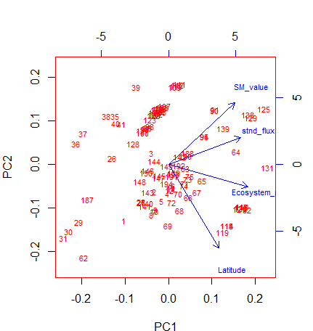
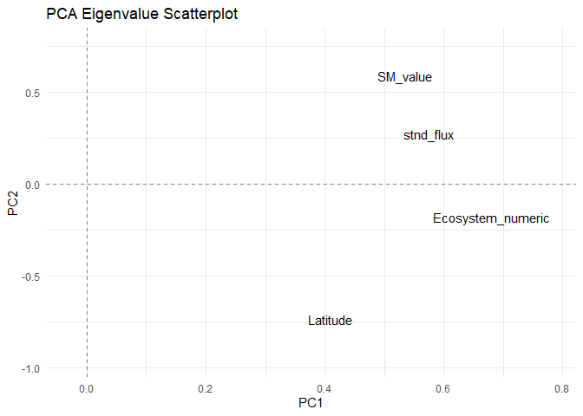
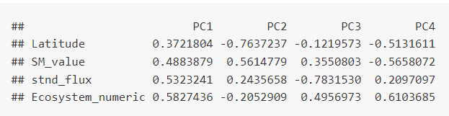
Results of PCA
Each red # is a row of data
Four Principal Components
PC1: CH₄ flux and Ecosystem
PC2: Soil Moisture and Latitude
PC3: Flux
PC4: Ecosystem
(Top) Biplot of first two principal components
(Bottom) Eigenvalue matrix of principal components

Slide 19
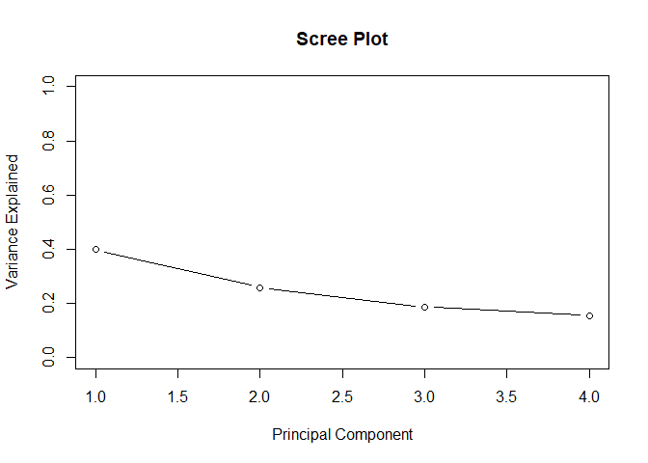
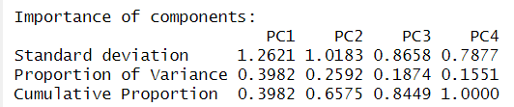
Importance of Components
Majority of variation can be explained by first three PC
Ecosystem type and soil moisture determine the variance the most

Slide 20
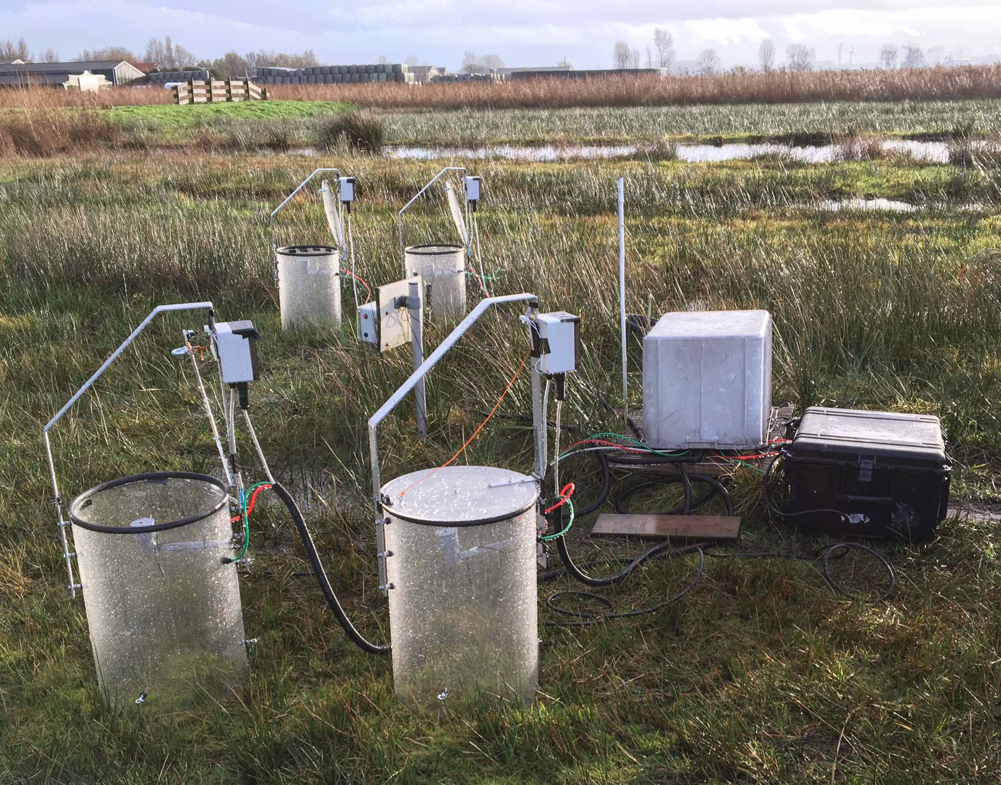
Summary + Takeaways
Soil moisture and ecosystem type are primary sources of CH₄ flux
Underscores importance of measuring soil moisture dynamics
Critical to consider other auxiliary variables
Ecosystem, latitude, and other factors are influential
Analysis reinforces understanding of CH₄ flux patterns
Still exists knowledge gap in management techniques to mitigate GHG
Potential skewing of data
Categorical -> quantitative conversion of ecosystem

Slide 21
Acknowledgements
Special thanks to…
Kendal Morris
Ben Bond-Lamberty
Juan Lopez and Emily Dykes
JGCRI Admin Team
Snack group
Repository Link:
https://github.com/brsukim/Methane

